Slide 1
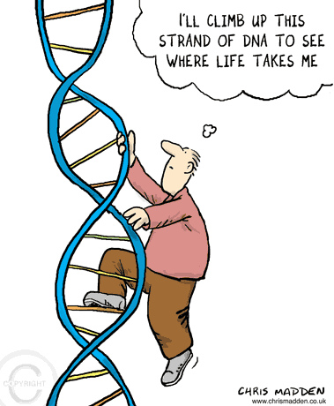
BB 2950: Molecular Biology
Prof. Scarlet Shell
TA: David Dolivo
PLA: Kaitlyn Valla

Slide 2
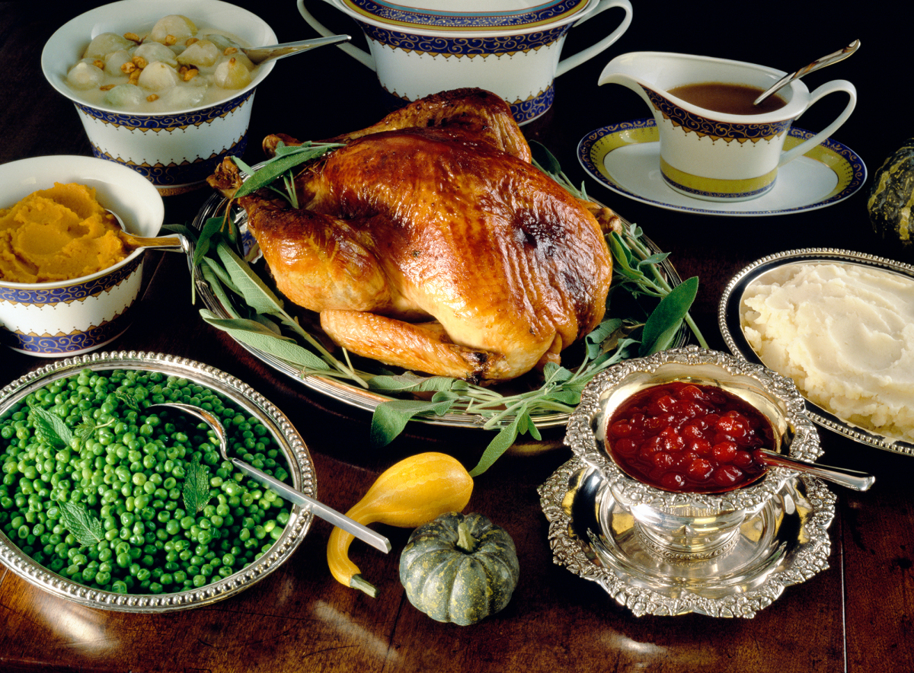

Photo: Femina/Camera Press/Redux downloaded from the NewYorker
Molecular Biology: the flow of biological information.
How cells use biological information
How cells replicate biological information

Slide 3
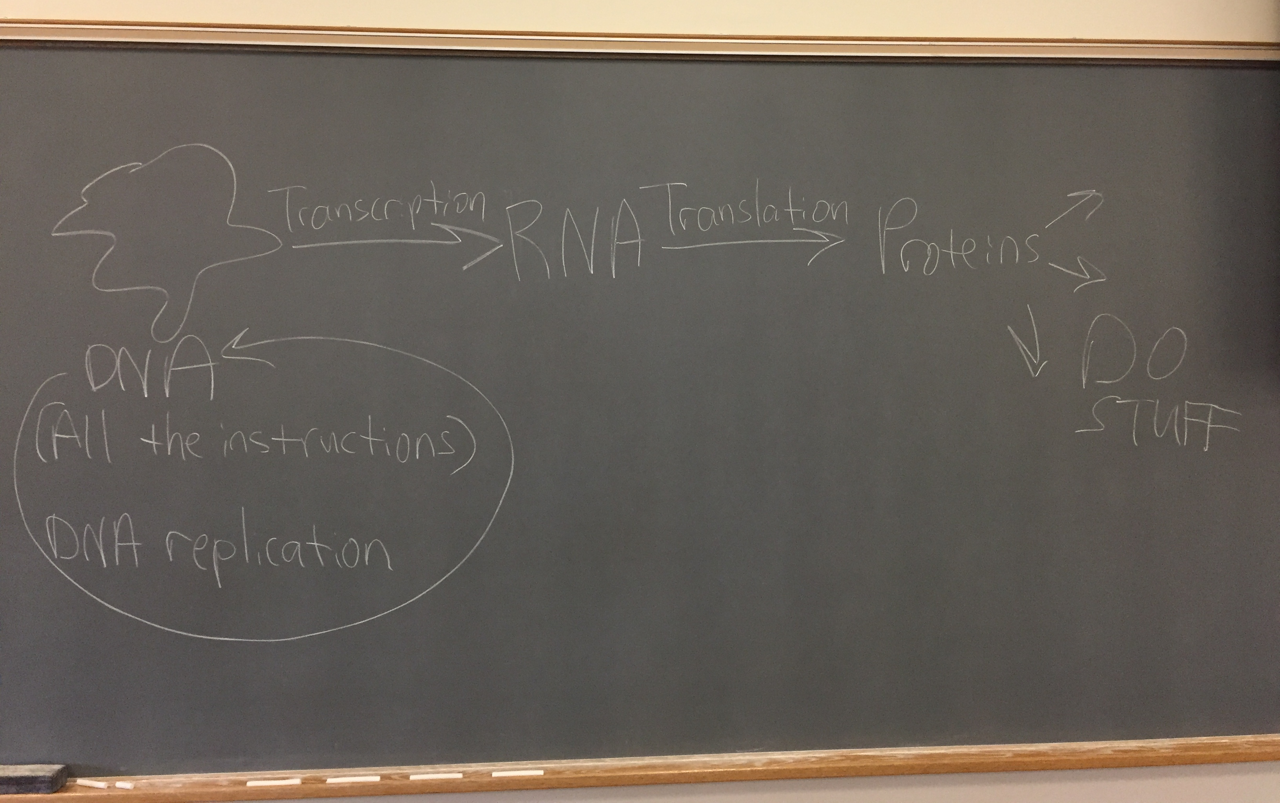
Molecular biology is:

Slide 4
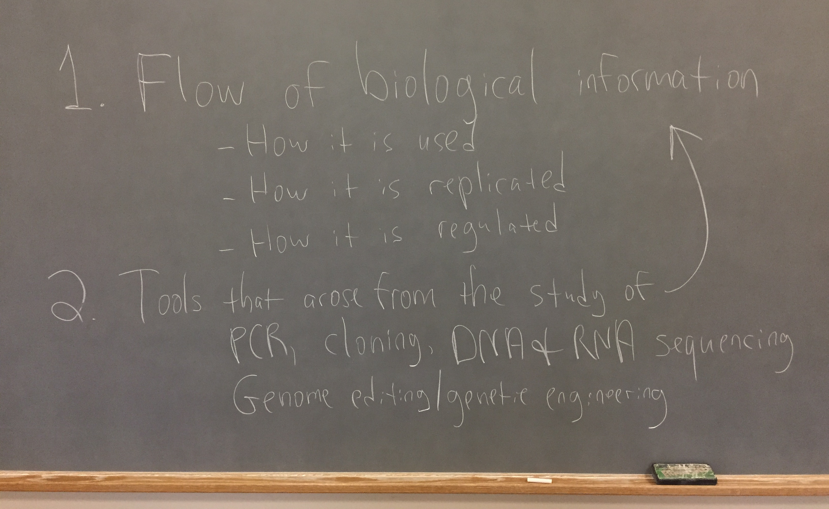
Molecular biology is:

Slide 5
Why is molecular biology important?
If you want to…
Genetically engineer plants, animals, algae, or microbes
Diagnose infectious diseases or genetic disorders
Deduce the epidemiology of infectious diseases
Solve crimes

Slide 6
Why is molecular biology important?
If you want to…
Genetically engineer plants, animals, algae, or microbes
Diagnose infectious diseases or genetic disorders
Deduce the epidemiology of infectious diseases
Solve crimes
If you want to understand…
How a single cell can turn into an entire human being
How a microbe or a cancer develops resistance to a drug
The impact a mutation will have on an organism
How cells or organisms respond and adapt to changing conditions
How contemporary organisms evolved from a soup of chemicals

Slide 7
Getting what you want out of this course
Come to class.
Do the reading:
Before class: light read/skim.
After class: read more closely to reinforce and flesh out what you learned.
Review your notes, lecture slides, and lists of important terms and concepts after class:
Identify points of confusion and use available resources to clarify them (book; ask a friend; post on the discussion board; schedule office hours with me).
Leave your phone in your bag when not in use (if you are bored: doodle!)
Consider taking notes by hand instead of on your computer.
Take notes on discussions too!

Slide 8
We will use Poll Everywhere to grade your attendance and participation
Bring a web-accessible device to class
Borrow one from the ATC if you don’t have your own
Answer questions at PollEv.com/sshell

Slide 9
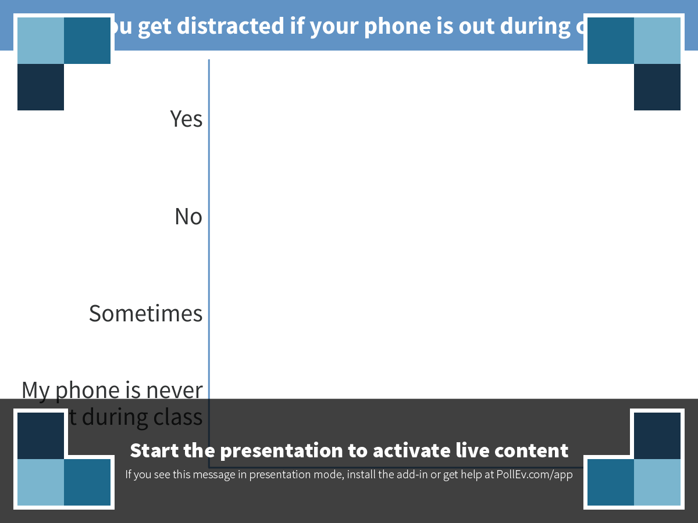
Notes:
Poll Title: Do you get distracted if your phone is out during class? https://www.polleverywhere.com/multiple_choice_polls/RhY0BI1bKJkAUGQ

Slide 10
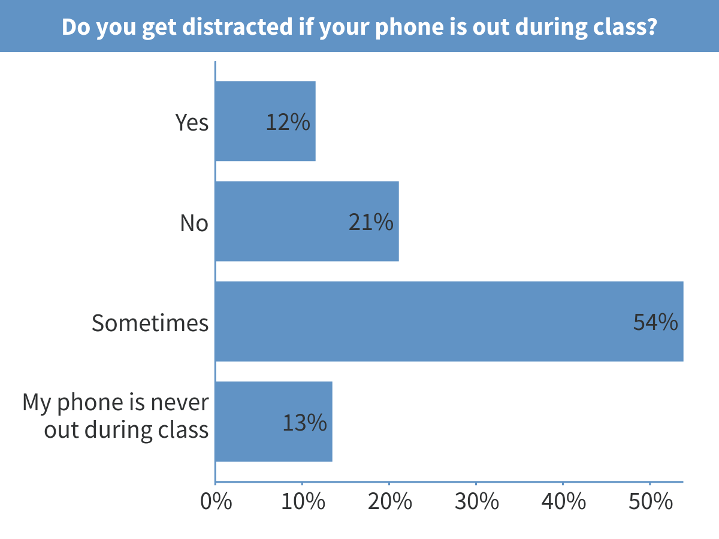
Notes:
Do you get distracted if your phone is out during class?

Slide 11
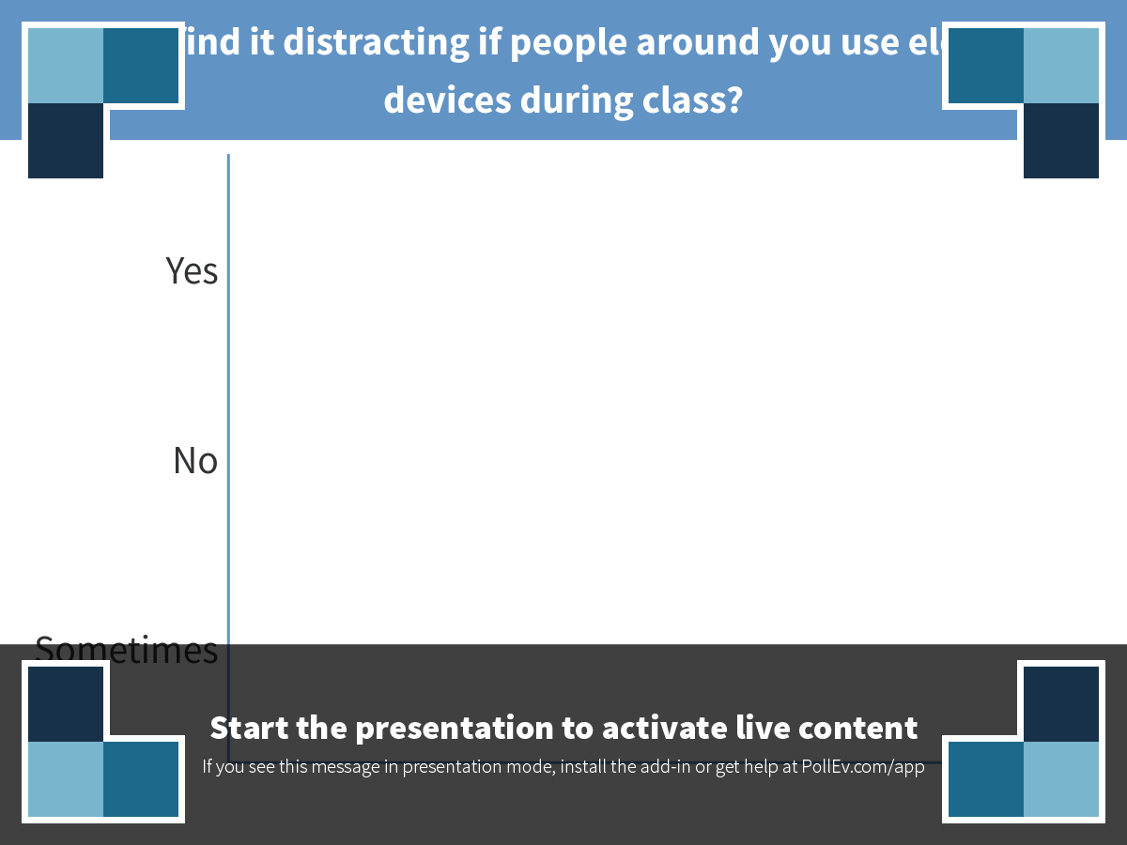
Notes:
Poll Title: Do you find it distracting if people around you use electronic devices during class? https://www.polleverywhere.com/multiple_choice_polls/MHw2axYLJEkQlIh

Slide 12
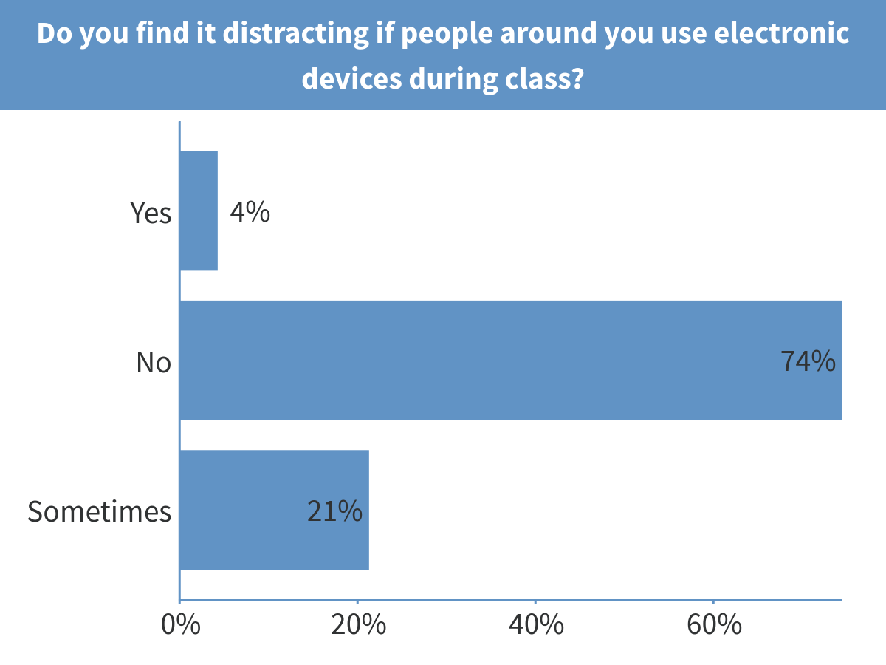
Notes:
Do you find it distracting if people around you use electronic devices during class?

Slide 13
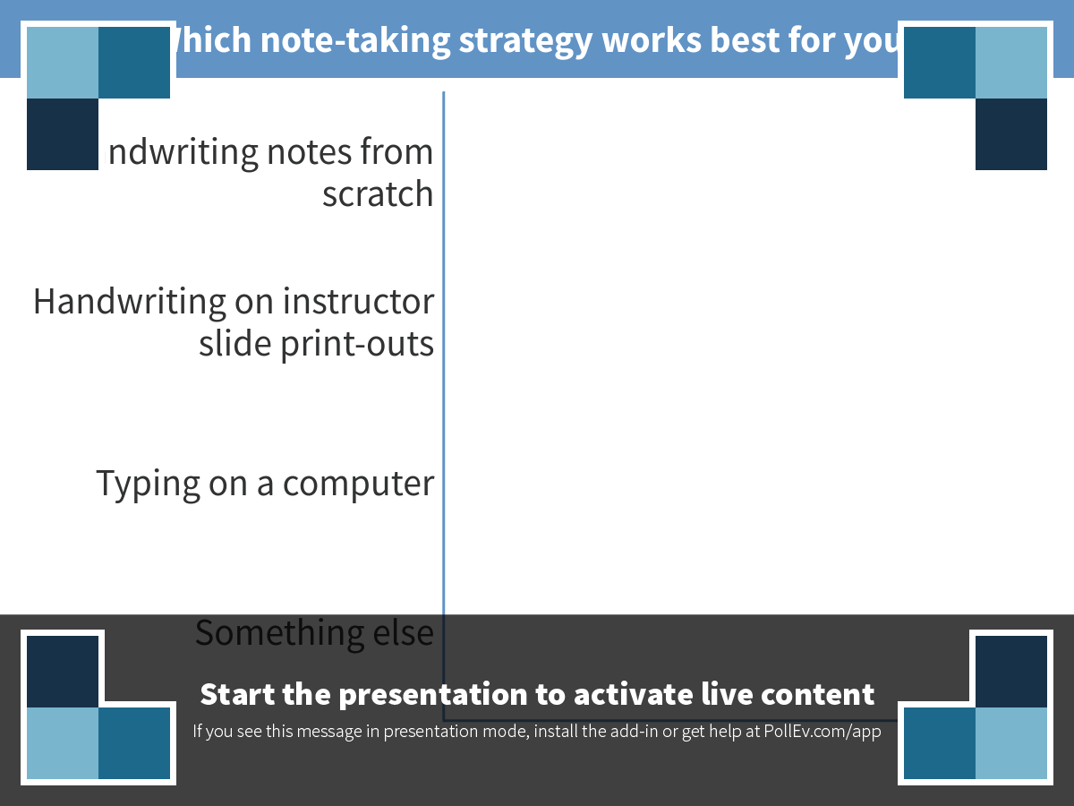
Notes:
Poll Title: Which note-taking strategy works best for you? https://www.polleverywhere.com/multiple_choice_polls/bRrB0bT8ZKYfy9t

Slide 14
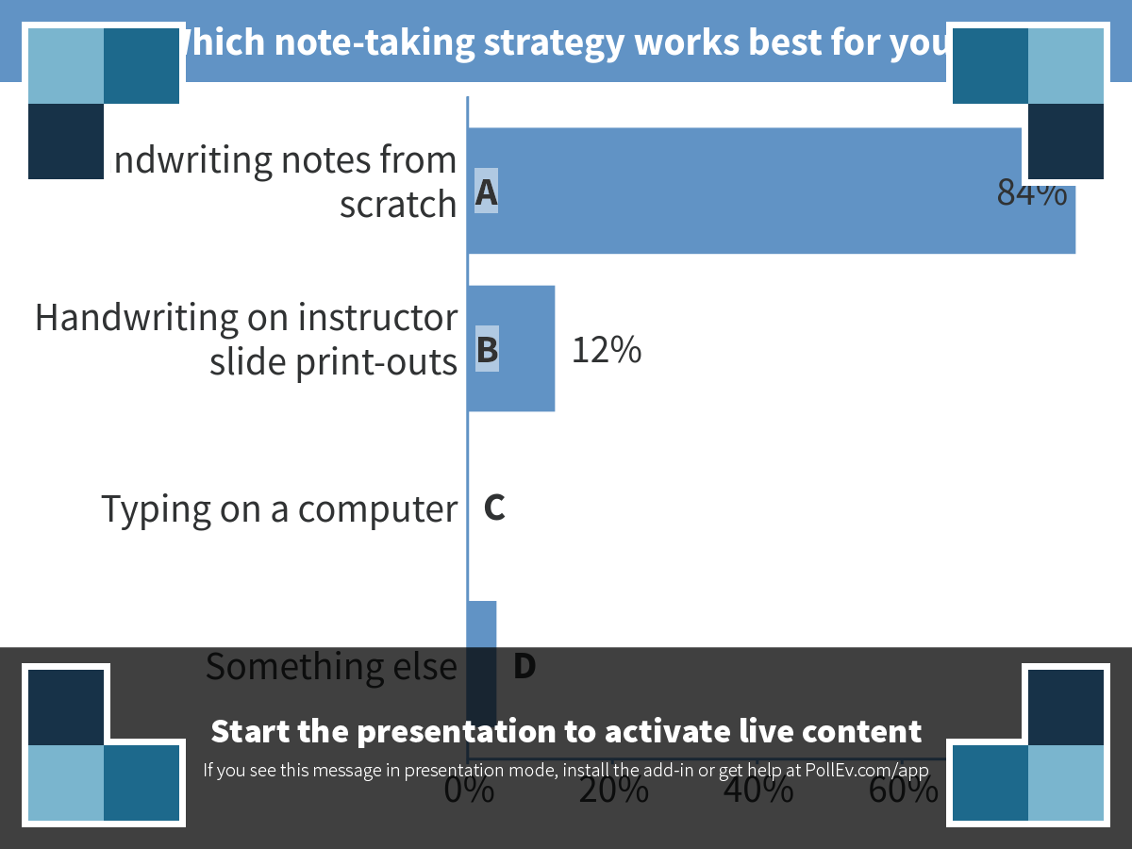
Notes:
Poll Title: Which note-taking strategy works best for you? https://www.polleverywhere.com/multiple_choice_polls/bRrB0bT8ZKYfy9t

Slide 15
Study tools available to you
Wednesdays: no regular class. Review sessions or office hours, depending on the week (see schedule in syllabus).
Additional office hours by appointment.
Class capture (assuming Prof. Shell has it set up correctly; tell me if lectures don’t show up on canvas).
Powerpoints with (semi-legible) annotations (on canvas after each class).
Lists of important terms and concepts (on canvas after each class).
Canvas discussion board. Make Prof. Shell happy!

Slide 16
Key items on syllabus
Learning outcomes
Exam and quiz dates
Tentative schedule of topics
Book information and reading assignments
Grading formula and policies
Procedure for requesting accommodations
Other policies
READ IT READ IT READ IT!

Slide 17
Assignments for the rest of the week
Follow instructions on canvas to change your Poll Everywhere password. This will complete your registration and allow you to get attendance credit for the rest of the term.
YouTube video: https://www.youtube.com/watch?v=D3fOXt4MrOM
Readings listed in the syllabus
An overview of molecular biology and its importance
Nucleic acid structure
Chemical principles important for understanding the basic biochemistry of proteins and nucleic acids
PCR: how it works and why it’s useful

Slide 18
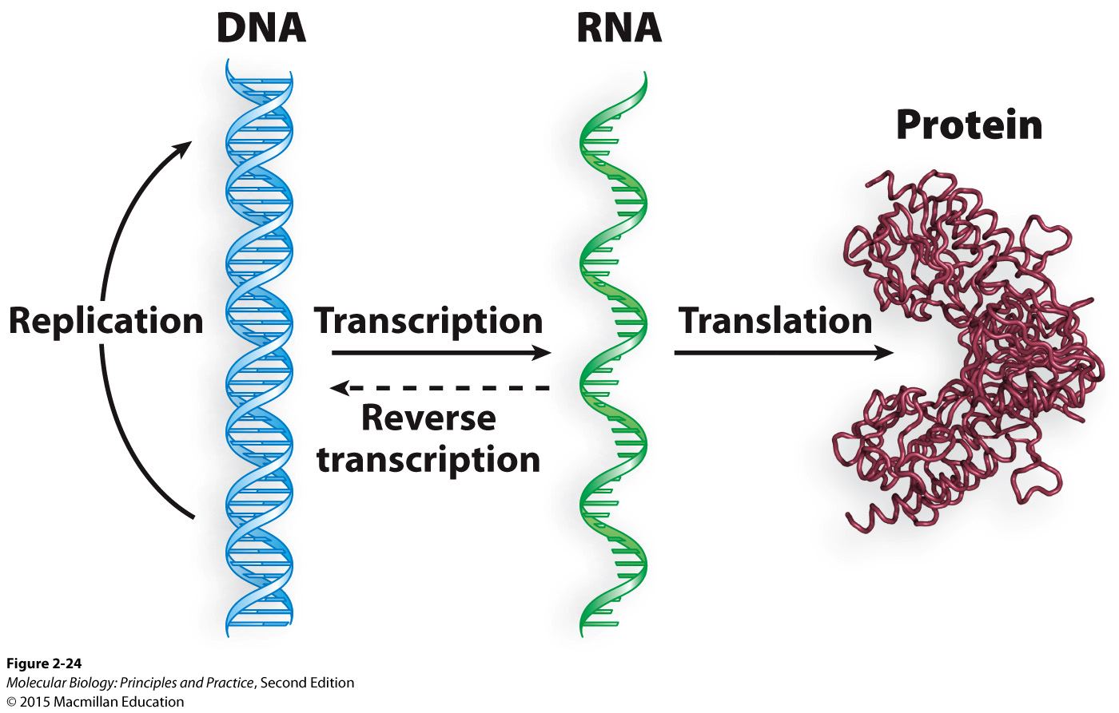
Completing our schematic of genetic information flow with additions to the “central dogma”
Notes:
Draw in RNA replication (example: polio virus)
Reverse transcription: examples are HIV and telomerase

Slide 19
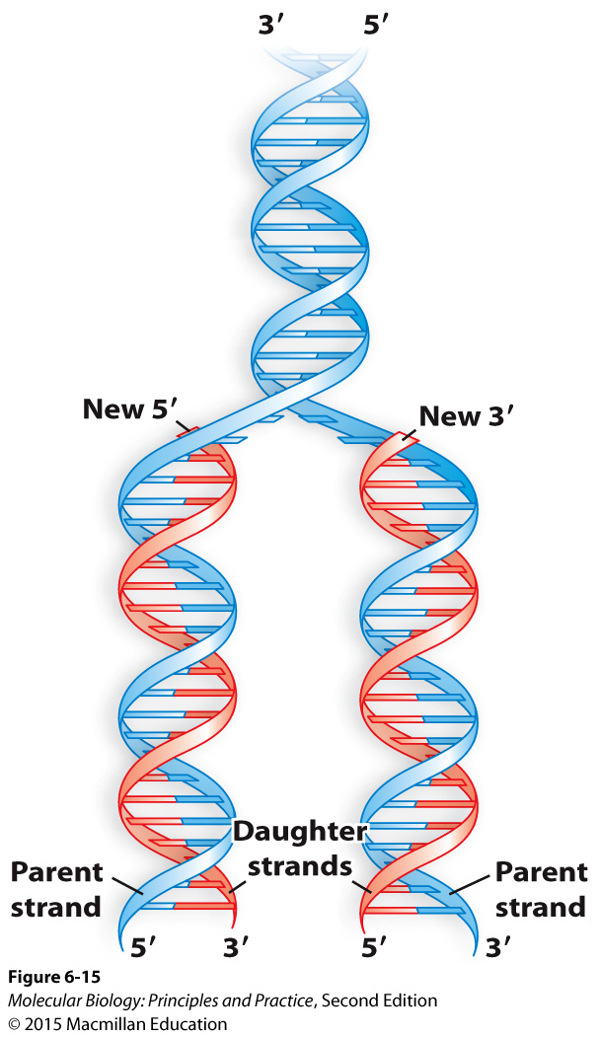
The complementary nature of dsDNA provides an obvious mechanism for its duplication (DNA replication)

Slide 20
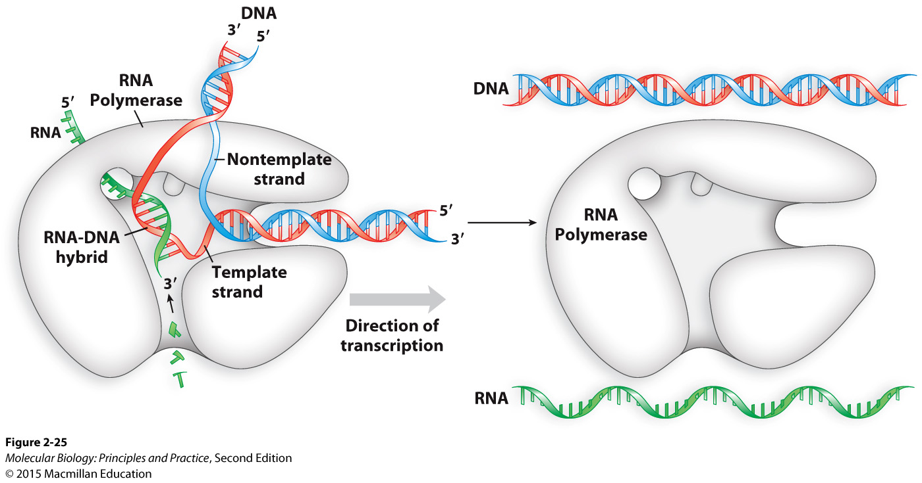
The structure of DNA also provides a mechanism for making RNA copies (transcription)

Slide 21
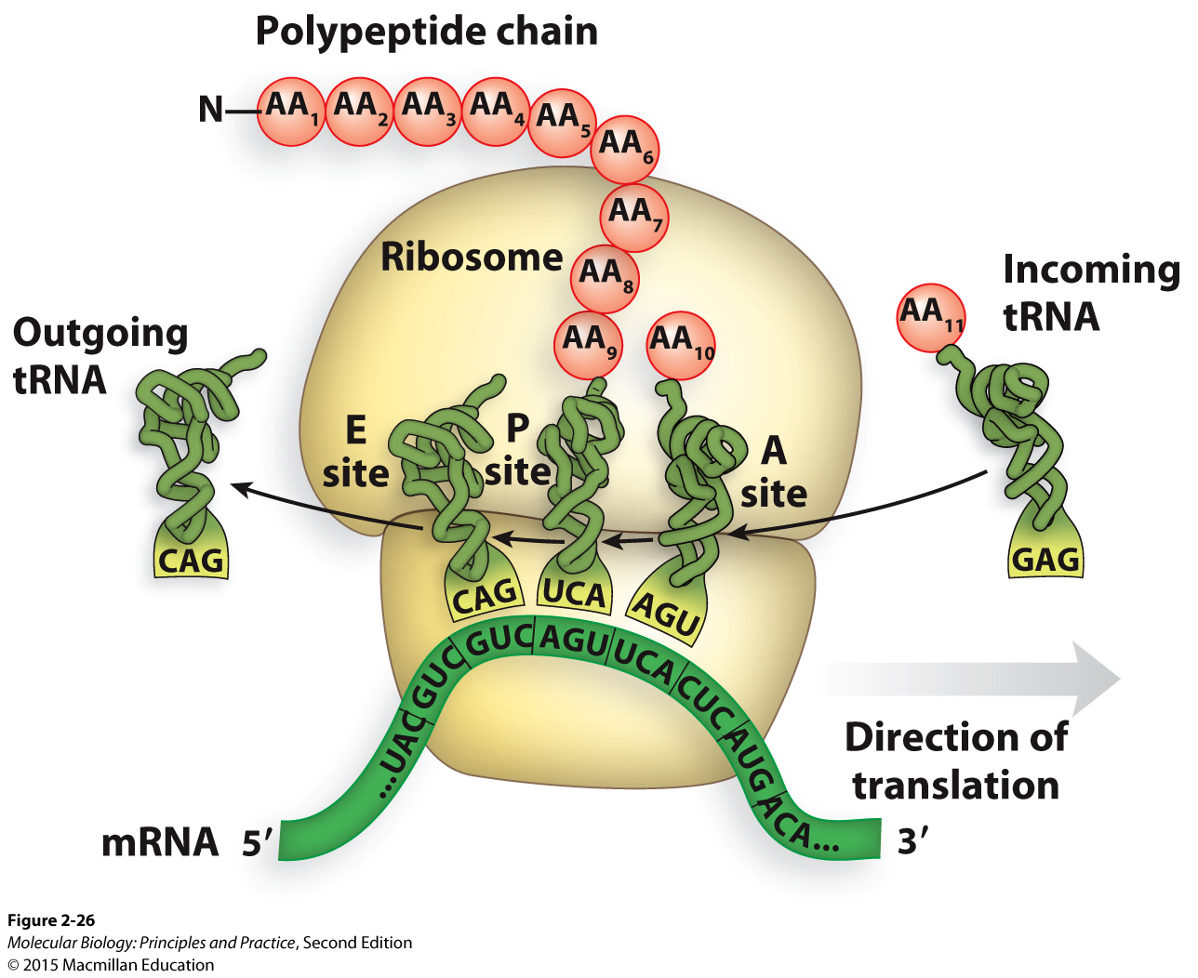
The ribosome uses tRNAs to “decode” the mRNA message (translation)

Slide 22
Get-to-know-you survey
Ungraded, but you must turn it in to receive your attendance/participation credit for today

